Slide 1
Day 2
OOP, Unit Tests, Collections

Slide 2
WIFM
Collections
LINQ
Yield
OOP - Object Oriented Design
Classes, Abstract Classes, Interfaces
Private, Protected, Public
Inheritance, overriding, overloading
Unit Testing
Why? JK
Mocking

Slide 3
Collections
List, Array, HashMap
Enumerable
Linq
Yield

Slide 4
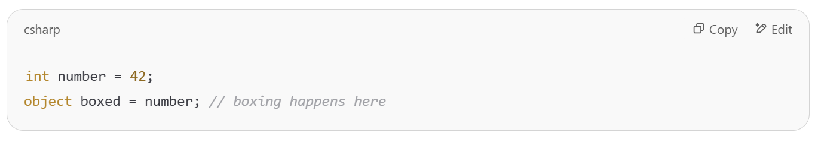
(Boxing / Unboxing)
Boxing is the process of converting a value type (like int, bool, struct) into a reference type (object)
The value is copied into a new object on the heap
This creates heap allocation and performance overhead

Slide 5
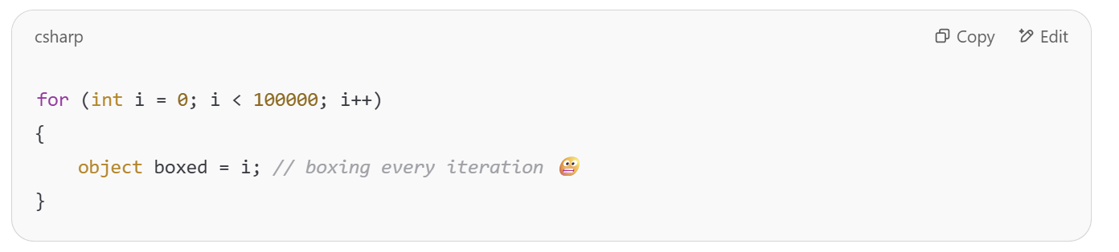
(Boxing / Unboxing)
Extra GC pressure: every boxed value = heap allocation.
Slower execution: both boxing and unboxing are more expensive than just using value types directly.
Unboxing ((string)…) is unsafe

Slide 6
Generics - <T>
What is generics?
When is it useful?
Notes:
✅ What are Generics?
Generic types allow you to write flexible, reusable code.
They let you define classes, interfaces, and methods with a placeholder type (T).
📦 Why use them?
Type safety at compile-time (no casting)
Code reuse (one class for any data type)
Better performance (no boxing/unboxing)

Slide 7
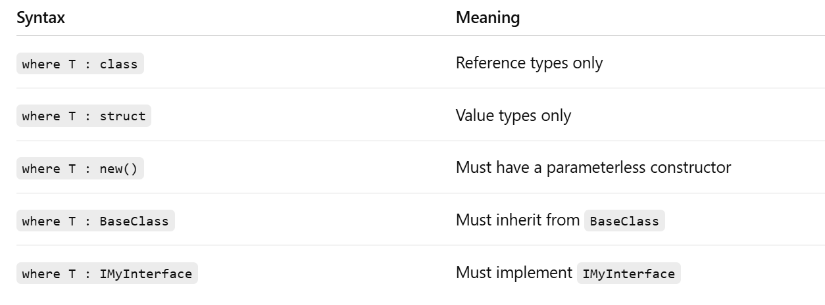
Generics - Constraints

Slide 8
ITaskRepository - Generic
Notes:
Let’s do this!

Slide 9
Linq
LINQ is a concise, readable way to query and manipulate data collections using SQL-like syntax directly in C#

Slide 10
Linq
Where
Count
Select
Find
First
Any, All
Group

Slide 11
Linq (exercise)
List<TaskItem> tasks = new()
{
new TaskItem { Title = "Fix television" },
new TaskItem { Title = "fix computer" },
new TaskItem { Title = "Fix fridge", Description = "This is urgent!" },
new TaskItem { Title = "This is a very long title to demonstrate something. What? I don't know", Description = "[Urgent]" },
new TaskItem { Title = "Water the plants" },
new TaskItem { Title = "Take out the trash" },
};
Notes:
Together: Return all tasks where the title starts with "Fix".
Get all titles of tasks that have a non-empty description.
Count how many tasks have the word "urgent" in the description.
Return a list of IDs of tasks whose title is longer than 20 characters.
Return the task with the longest description (null-safe).
Group tasks by the first letter of the title.

Slide 12
yield
Lazy evaluation
Cleaner code for filters
IEnumerable
Notes:
List all files vs Enumerate files example

Slide 13
Func vs Action
Pass a function as a parameter
Action<X, Y, Z> - A function that receives (X, Y, Z) as parameters and returns nothing
Func<X, Y, Z> - A function that receives (X, Y) as parameters and returns Z
Notes:
They need to implement: “get tasks by predicate”

Slide 14
OOP
I hope you know what it is!
We created an interface for our TaskManager
Why? For what?
Let’s make different type of tasks
Deadline task
Meeting task
Task of tasks
Notes:
OOP: Encapsulation, Abstraction, Inheritence, Polymorphism
“Has a” vs “Is a”
✅ Use interfaces to define contracts
✅ Use composition to build functionality from small parts
⚠️ Use inheritance only when there's a clear "is a" relationship and shared behavior
🆚 override vs new in C#
✅ override
Used when the base method is marked as virtual (or abstract).
Enables true polymorphism: the derived method gets called even if you're using a base class reference.
public class TaskItem
{
public virtual void PrintSummary() => Console.WriteLine("Task");
}
public class MeetingTask : TaskItem
{
public override void PrintSummary() => Console.WriteLine("Meeting Task");
}
TaskItem t = new MeetingTask();
t.PrintSummary(); // ✅ "Meeting Task"
🆕 new
Hides the base method — not overriding, just replacing it in the derived class if accessed through that type.
Base method still runs if you're using a base class reference.
csharp
CopyEdit
public class TaskItem
{
public void PrintSummary() => Console.WriteLine("Task");
}
public class MeetingTask : TaskItem
{
public new void PrintSummary() => Console.WriteLine("Meeting Task");
}
TaskItem t = new MeetingTask();
t.PrintSummary(); // 😬 "Task"
MeetingTask mt = new MeetingTask();
mt.PrintSummary(); // ✅ "Meeting Task"
You almost always would want to use override

Slide 15
Tests
Why? What? How?

Slide 16
Why?
To make sure everything work
To allow future developers (and ourselves) to make changes with security

Slide 17
What?
Everything
But
We don’t test IO We mock it

Slide 18
How?
xUnit
Moq (Later on)
Naming convention: WhatWeTest_InputToTest_ExpectedResult
Let’s start!
Notes:
Create a UnitTest project
Test InMemoryTaskRepository

Slide 19
Lunch Break

Slide 20
FileSystemTaskManager
Let’s save our tasks in our file system!
Notes:
First try should fail as the file is consistent.
Let’s talk about Moq and IFileSystem
System.IO.Abstractions

Slide 21
Let’s move our tests to the new TaskManager!
Notes:
Won’t work ☺

Slide 22

Mock
Notes:
What is a mock?
What do we mock? The closest to the real thing, don’t mock unnecessary things
Install Moq
Use context

